Slide 1

Cyber Security
Corporate Citizenship IBM
E Week
IBM
Co
ארי ציגלר
XIV
Notes:
Presenting myself
XIV – a storage company
what drew me to talk about security
what we’re going to cover today

Slide 2

Corporate Citizenship IBM
E Week

Slide 3
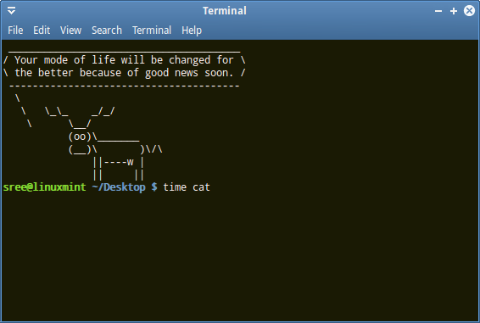
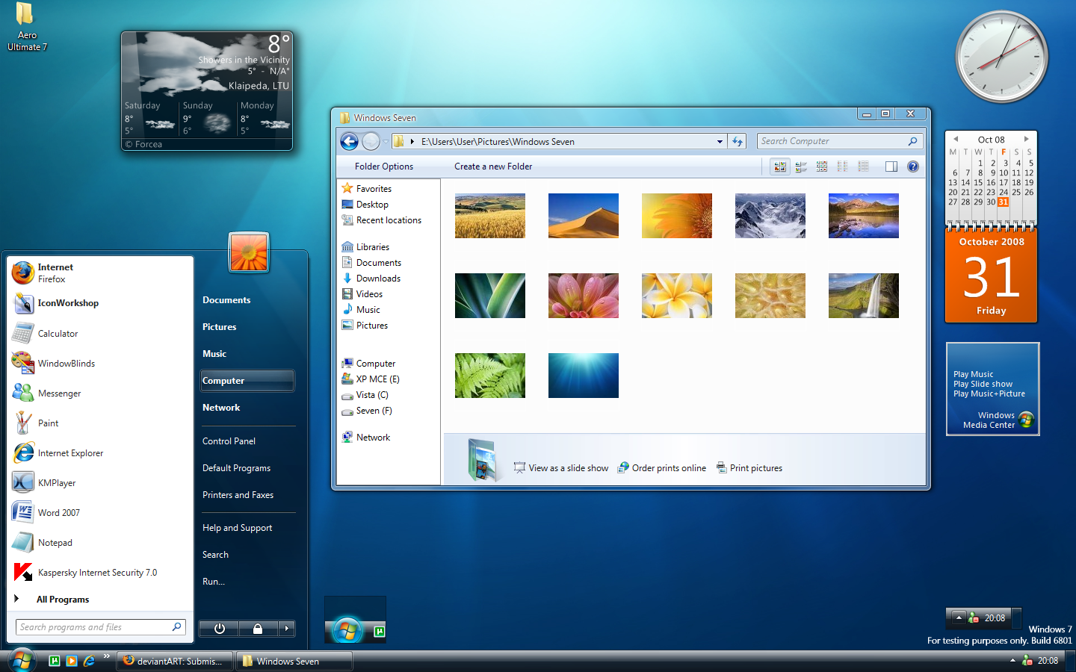
Corporate Citizenship IBM
E Week

Slide 4
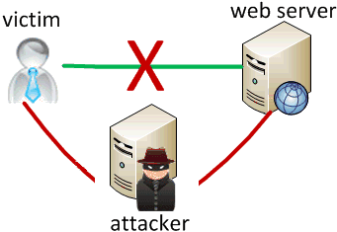
Corporate Citizenship IBM
E Week

Slide 5
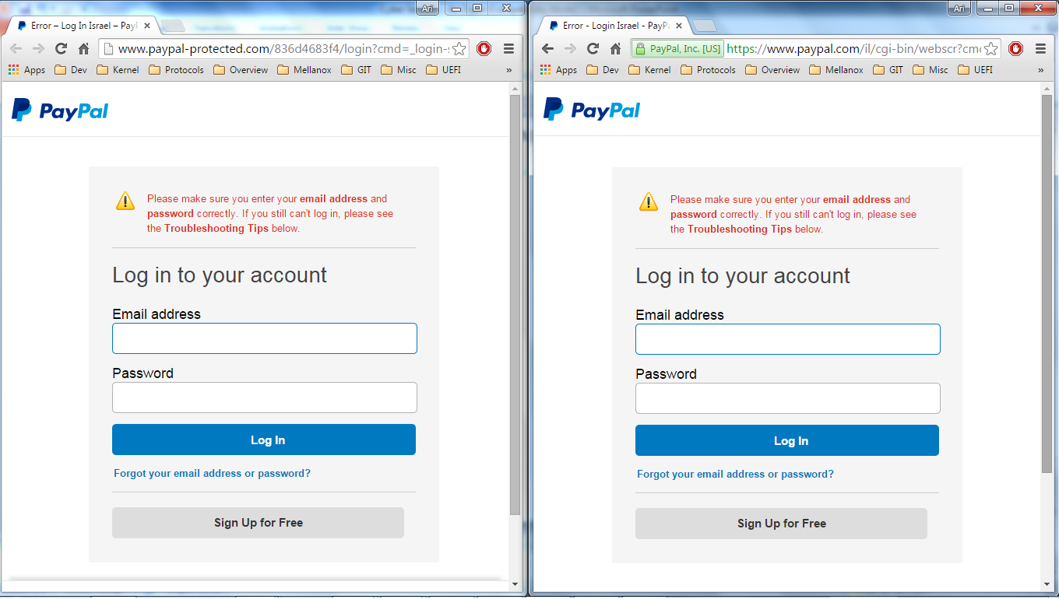
Corporate Citizenship IBM
E Week

Slide 6
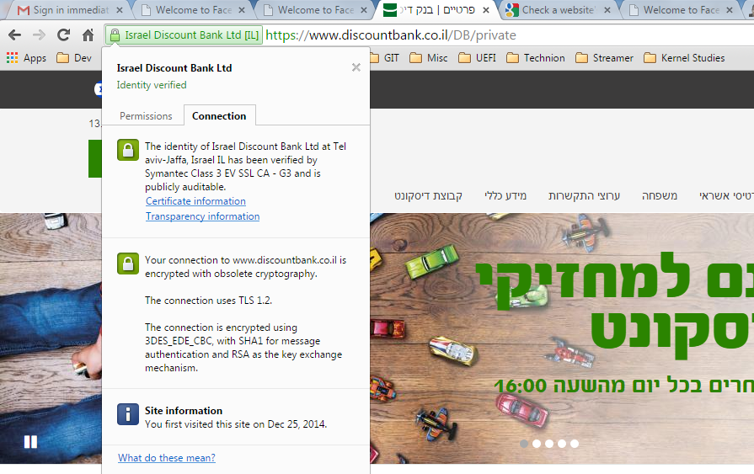
Corporate Citizenship IBM
E Week

Slide 7
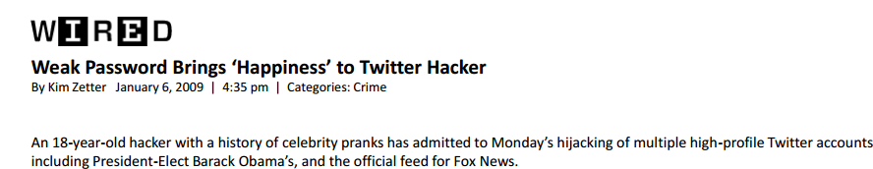
Corporate Citizenship IBM
E Week

